Slide 1
INVESTMENT CASE STUDY SUBMISSION
Group Name:
Sweta Kumari
Manish Anand
Annamalai Ganapathy
Jayakrishna Chakkirala

Slide 2
<Abstract>
The objective of this case study is facilitate Sparks Funds, an asset management company in making investments on other companies with below constraints:
It can invest between 5 to 15 million USD per round of investment.
It wants to invest only on English Speaking countries.
This case study helps Sparks Funds in understanding the market trend for investment by analyzing the below important factors:
Investment Type : This would help in narrowing down the best investment types suited for Sparks Funds to invest as it has constraints of investment amount.
Country : This would help in narrowing down the best suited English speaking countries for investment.
Sectors : This is the main factor for investment as it helps Sparks funds in deciding the main sector and primary sector best suited for investment.
All the above factors play key role for Sparks Funds in deciding the company name that it would prefer to invest with the constraints.In the end we would have the top 3 countries with the maximum number of investments in each sector.

Slide 3
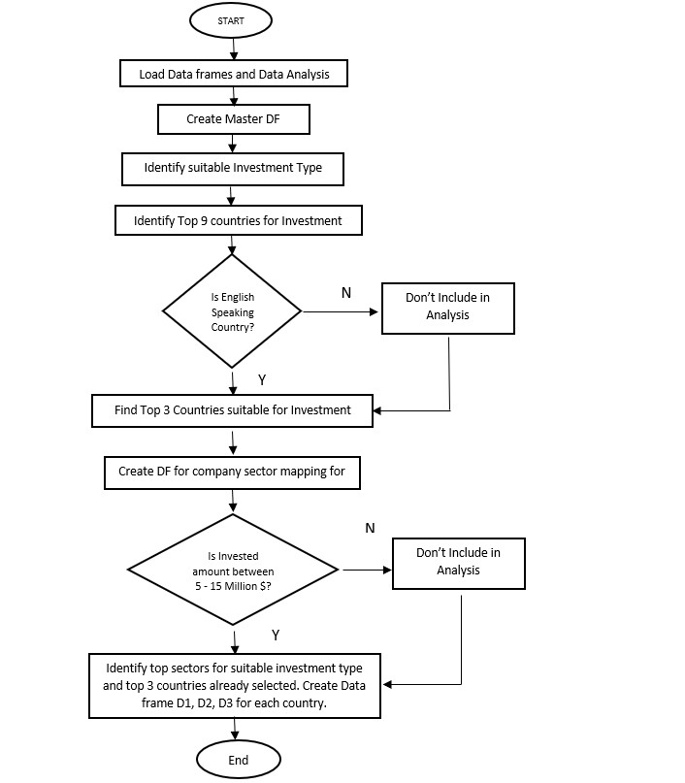
Problem solving methodology:

Slide 4
Funding Type Analysis
Steps undertaken for Investment Type Analysis :
Step 1: Load the data into data frames companies and rounds2
Step 2: Data cleaning for encoding issues
Step 3: Create master data frame by merging companies and rounds2 on attribute permalink/company_permalink
Step 4: Clean master data frame to only include companies with no null values for raised_amount
Step 5: Find the average amount raised by individual funding type
As Sparks Funds can invest in range of 5 -15 million dollars per round of investment we need compare the investment amounts in the venture, seed, angel, private equity etc. As seed/angel funding are for early startups and private equity involves a huge money for investment , Venture funding type seems appropriate investment type for Sparks Funds.
Assumptions : Companies with closed status is also considered in data analysis.

Slide 5
Country Analysis
Spark Funds wants to invest in countries with the highest amount of funding for the chosen investment type.
Step 1: Based on the selected investment type , ie Venture type in our case , filter the master data frame.
Step 2: Filter the data frame for only English speaking countries
Step 3: Find the sum of raised_amount for each country from the filtered data frame in step 2.
Step 4: Create data frame Top9 for the top 9 countries sorted in ascending order of the amount raised for Venture type funding.
Step 5: Determine the top 3 countries from the data frame Top9
As Sparks Funds prefers to invest in only English speaking countries, we need first filter the English speaking countries from the data frame for investment type Venture and then sort them in ascending order of amounts raised.
Top 3 countries for Sparks Funds potential investment :
USA
Great Britain
India

Slide 6
Sector Analysis
Spark Funds wants to invest in the most heavily invested main sectors in each of the top three countries for the chosen investment type.
Step 1: Map the primary sector to the corresponding main sector from the sector mapping data frame.
Step 2: Data cleaning for sector mapping data frame. Also data clean up for master data frame where category list is null.
Step 3: Find the primary sector of each company and map it to the main sector.
Step 4: For the top 3 English speaking country with the selected funding type and investment amount between 5 -15 million dollars , create new data frames D1 , D2 , D3 with new columns primary sector and main sector.
Step 5: Find the main sector for each country that has received maximum investment.
Step 6: Find the number of investment and Amount Invested for each main sector in D1 , D2 and D3.
Step 7: Determine the top most company in the each sector which received the maximum investment.
Based on the sector analysis, the main sector that seems to be the best sector for investment type Venture and each of the top 3 countries shortlisted in the previous slides are :
Others
Social, Finance, Analytics, Advertising
Cleantech / Semiconductors (Except for India it is News, Search and Messaging)

Slide 7
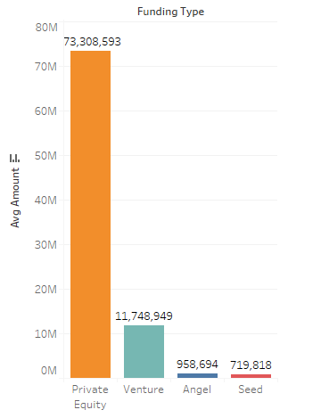
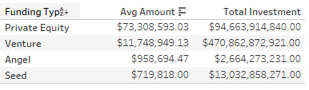
Results: Investment Type Analysis
Note: Investment Type analysis on funding type concludes that "Venture" funding type is most suitable for Spark Funds as Investment constraints of $5 to $15 million per investment round.

Slide 8

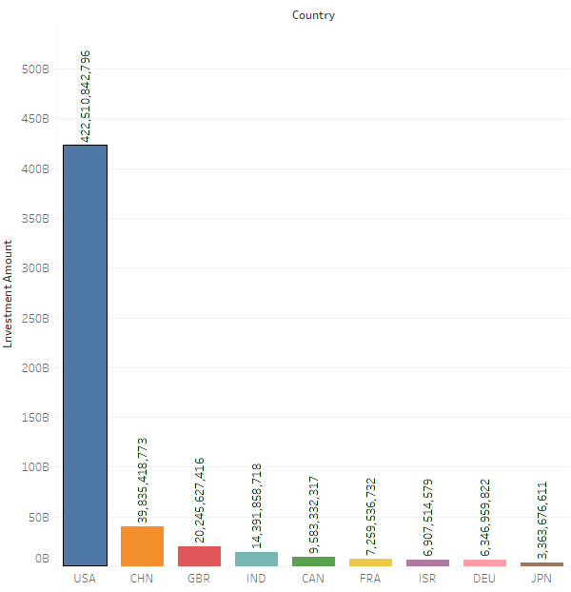
Results: Countries Analysis
Note: Country Analysis shows the TOP 9 Countries with the Total Investments made and excluding the English Speaking country "China" provides us the TOP 3 list of countries for Spark Funds to focus on - USA, Great Britain and India.

Slide 9
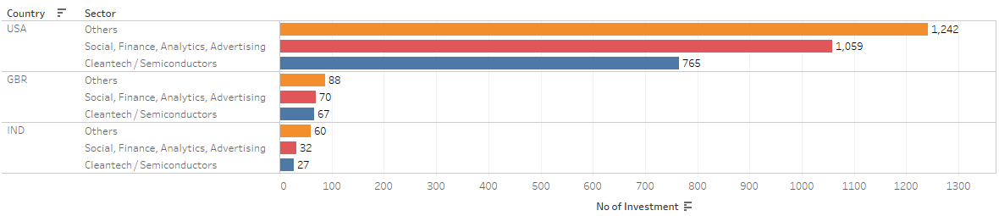
Results: Sector Analysis
Note: Sector Analysis shows top 3 sector to focus on by spark funds.
Based on the investment type and top 3 countries concluded in previous slides , the sector ‘Others' shows maximum investment by all the companies.

Slide 10
Conclusions
Based on the analysis done from the data provided by crunchbase.com to help facilitate Sparks Funds decide on the best company for investment , below is the conclusions :
Spark Funds should invest in ‘Venture’ type funding as the data shows strong market interest on that funding type for $5 – 15 million investment.
USA, Britain and India tops the list of English speaking countries and won the interests of all the investors.
The main three sectors that Spark Funds should focus is ‘Others’ , ‘Social, Finance, Analytics, Advertising’ and ‘Cleantech / Semiconductors’.

